Slide 1
Born Again Cloud
Information Builders, Inc.
Marc J. Greenberg Chief Architect
iWay Software

Slide 2
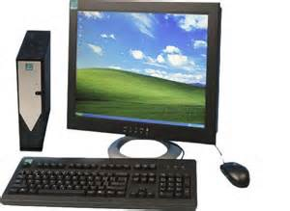
Architectural Evolution
80’s: Mainframe Unified, Cryptic, Monolithic, Limited
00’s: The Web Distributed, Scalable, Fragmented
10’s: Cloud Virtual, Scalable, Unified
90’s: Client Server Centralized, More Scalable, App Silos
DB
DB
DB
…
APP Server
DB Server
DB
Mainframe
Server
APP
DB
WebServer
APP
APP
APP
APP
APP
APP
TERMINALS
CLIENTS
BROWSERS
Devices / IOT
…
…
…
…
FOCUS Focnet
Focus for Windows EDA / SQL
WebFOCUS
iWay Service Manager
2

Slide 3
Separation of Responsibilities
NaaS
IaaS
PaaS
SaaS
Applications
Applications
Applications
Applications
Data
Data
Data
Data
Runtime
Runtime
Runtime
Runtime
Middleware
Middleware
Middleware
Middleware
O/S
O/S
O/S
O/S
Virtualization
Virtualization
Virtualization
Virtualization
Servers
Servers
Servers
Servers
Storage
Storage
Storage
Storage
Networking
Networking
Networking
Networking
3

Slide 4
Engineering costs / goals ?
CLOUD WASHED
CLOUD NATIVE
Migrate vs. Re-Architect
Decoupled from physical resources
Dynamic horizontal scalability
Multi-tenancy / Multi-instance
High availability / Automatic failover
Provide lifecycle management
4

Slide 5
The Twelve-Factor App Methodology
Codebase One codebase tracked in revision control, many deploys
Dependencies Explicitly declare and isolate dependencies
Config Store config in the environment
Backing Services Treat backing services as attached resources
Build, release, run Strictly separate build and run stages
Processes Execute the app as one or more stateless processes
Port binding Export services via port bindings
Concurrency Scale out via the process model
Disposability Maximize robustness with fast startup and graceful shutdown
Dev / prod parity Keep development, staging, and production as similar as possible
Logs Treat logs as event streams
Admin processes Run admin/management tasks as one-off processes
12factor.net
5

Slide 6
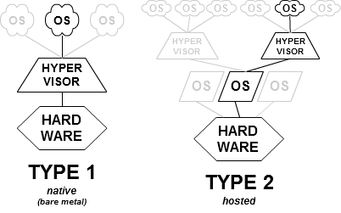
Virtualization Management
CP/CMS thru z/VM Citrix XenServer, VM/ware ESX/ESXi
Microsoft Hyper-V
VM/ware Workstation Oracle Virtualbox QEMU / KVM
TYPE 1.5 hybrid
(linux containers LXC) Docker
6

Slide 7
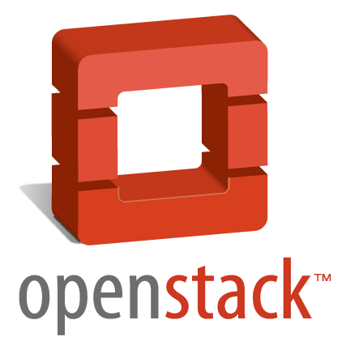
Pick a Stack - IaaS
Private / Hybrid solution for AWS
Rackspace and NASA (2010)
Adopted by Ubuntu (2011), Redhat (2012)
OpenStack Foundation 9/12 - 200+ members (brands)
Python / Apache2 v9 Icehouse - Momentum
Open Source Cloud Computing for IaaS
Cloud.com 2010, acquired by Citrix 7/11
Donated to ASF 4/12, TLP 3/13 v4.0.2
Java / Apache2 Deployments
Private / Hybrid solution for AWS
formal agreement for compatibility 3/12
acquired By HP 9/14
Java / C GPLv3 v 4.0.1 AWS Compatibility
7

Slide 8
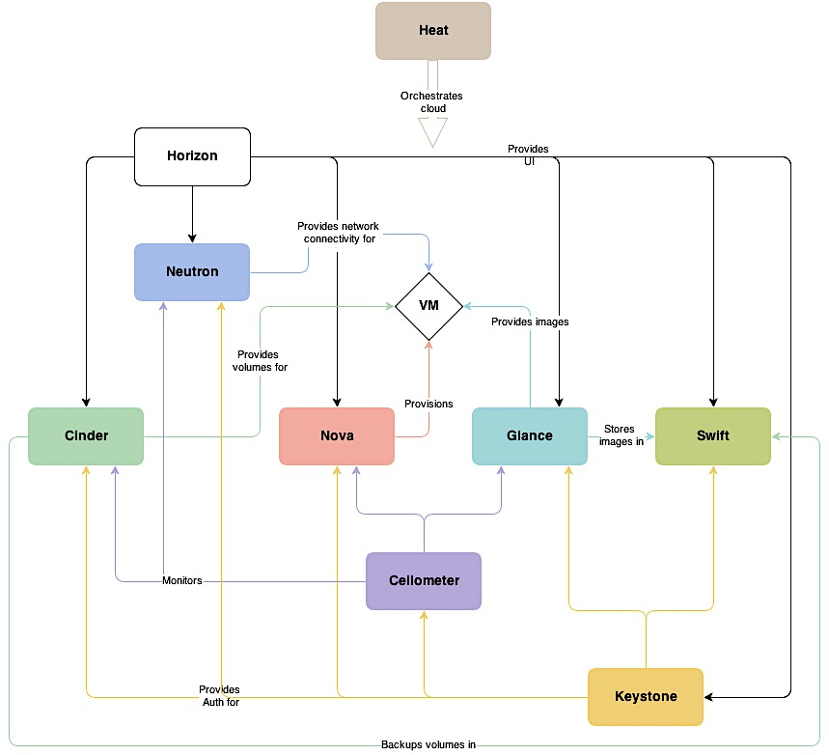
OpenStack Conceptual Architecture

Slide 9
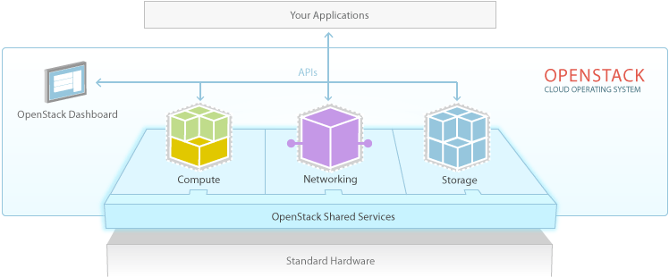
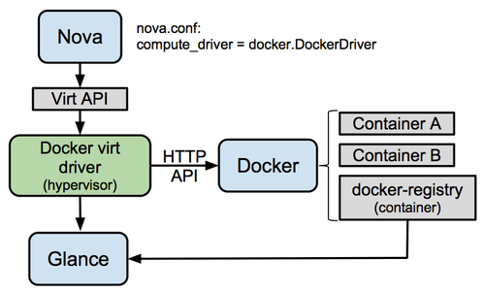
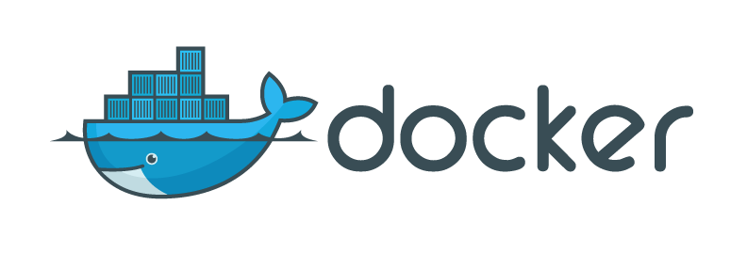
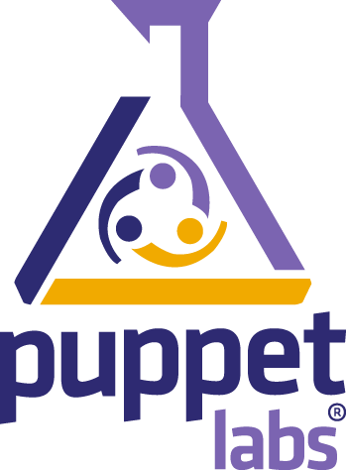
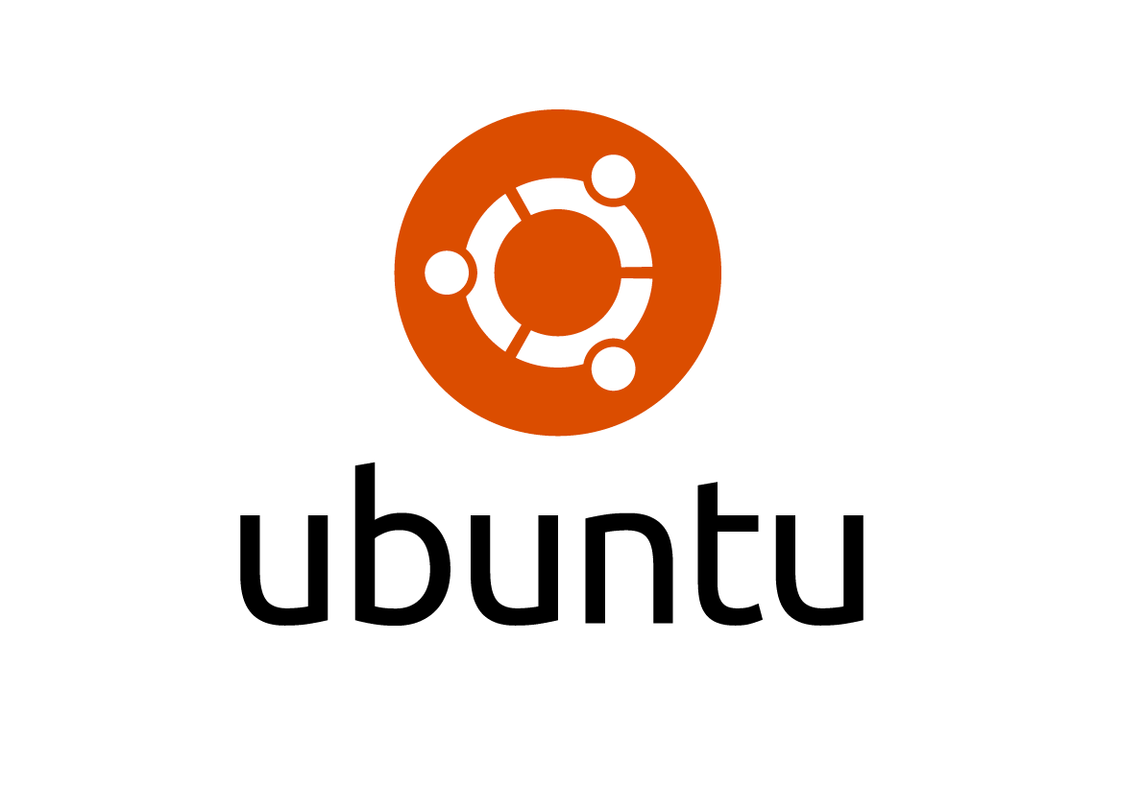
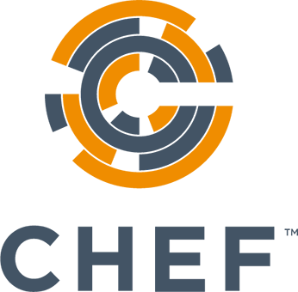
Openstacking iSM
9

Slide 10
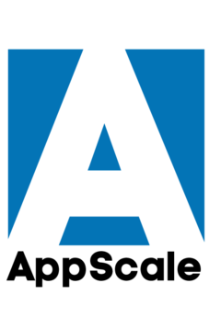
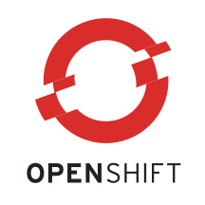
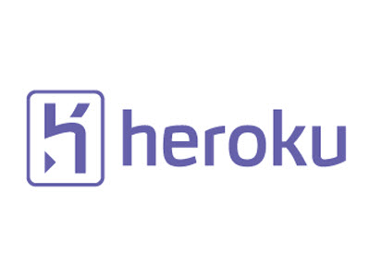
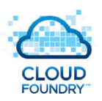
Pick a Platform - Plug into existing PaaS
CloudFocus Logo Here
Focus Dialog Manager, Cactus, Maintain
CLI (Focus Command Line), like node REPL (Read-Evaluate-Print-Loop
Automatically deploys and scales unmodified Google App Engine applications
Python, Ruby, Java, Go, PHP
Red Hat’s platform that automates the provisioning, management and scaling of applications
JavaScript, Ruby, Python, PHP, Perl, Java, Haskell, .NET
Dynos – abstract computing environments
LXC containers – web or worker types
Salesforce.com (force.com 2010)
Python, Java, Scala, Clojure, PHP, PERL and Node.js
Pivotal, Vmware, EMC Corporation
Java, Ruby, Node.js, Scala, Python, PHP
10

Slide 11
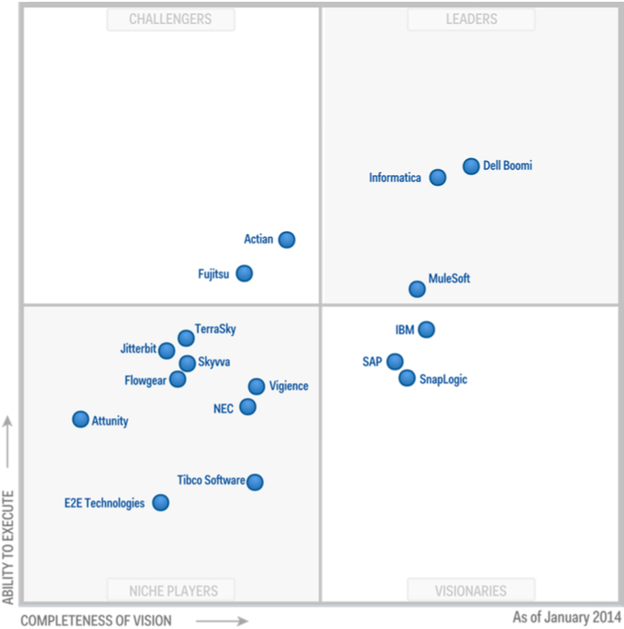
Pick a Platform – Create Native iPaaS
Cloud-based software tools that govern the interactions between cloud and on-premises applications, processes, services and data.
Dell Boomi AtomSphere iPaaS | CSI, B2B, MDM, DQ, EAI
Informatica Cloud | ETL with Salesforce, 1800 Customers process engine aas
MuleSoft CloudHub | Shared Multitenant APIs 170 Enterprise Customers
IBM Cast Iron Live | CSI, DevOps, Web based
SAP Hanna Cloud Integration | Solid Roadmap, HCI cloudstreams
SnapLogic | Pureplay replacement of on-premise integration software
Partnering Opps with Saas Vendors
Packaged Integration
Salesforce.com, Workday, NetSuite, Taleo, SuccessFactors and RightNow
11

Slide 12
Cloud Architecture Exploration
Create a private cloud using OpenStack Icehouse
29th floor, 2 machine config (controller, compute1).
Had to start from scratch 3 time so far (probably need a few more)
Steep learning curve, Still not running properly
need 3 machine config, network config is painful
Create a developer version of Icehouse (Devstack) using tools like Vagrant and Virtualbox, per cookbook on Linux, Mac and Windows
Create a docker environment and containers for:
iway | ubuntu 14.04.1 + java7
sentinel | iway + tomcat + sentinel
ism | iway + ism
egret | Iway + jetty + egret
12

Slide 13
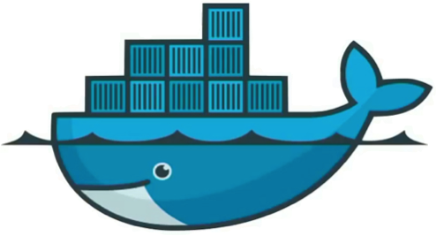
CIBI
Docker – Build, Ship and Run
Provides a uniformed wrapper around a software package Portable deployment across machines
webfocus
focus
egret
ism
mysql
sentinel
tomcat
mongo
LXC (LinuX Containers)
libvirt: Platform Virtualization
Layered File System
Linux distros (Ubuntu, Fedora, RHEL, Centos, openSUSE, ...)
Cloud (Amazon EC2, Google Compute Engine, Rackspace)
Microsoft with next release of Windows Server
13

Slide 14
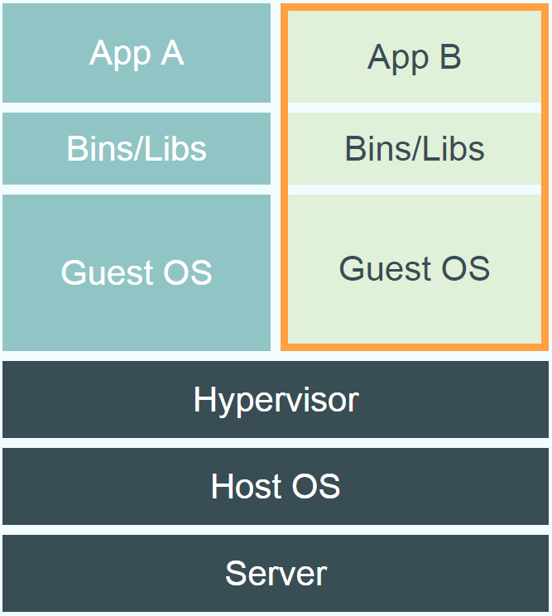
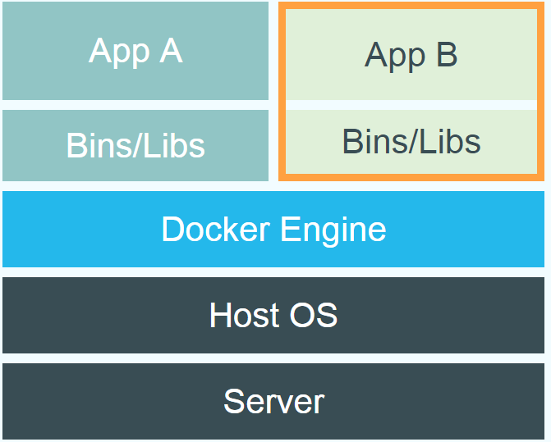
CIBI
Docker vs. Virtual Machine
Source: https://www.docker.com/whatisdocker/
14

Slide 15
CIBI
Docker Registry
Docker image / version control: push, pull and tag images
Private, Self Hosted - see odin.ibi.com
Private 3rd Party Hosted, quay.io, jfrog, microsoft, and recently google
Public / Private Official + Trusted Builds: https://registry.hub.docker.com/
15

Slide 16
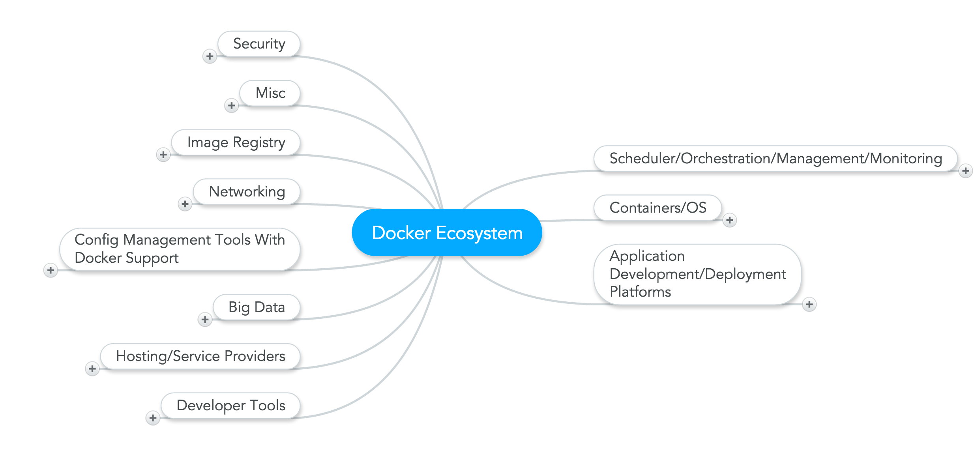
Docker Ecosystem
www.mindmeister.com/389671722/docker-ecosystem
16

Slide 17
CIBI
An Example - XmlArchive
What does it do?
What does it depend on?
How do I know it is working?
Runs xmla.sh to ② configure the env
xmla (ism)
Archive data to mongodb ⑤
Uploads ①
docker port xmla 9999 finds ism console port
Deploys XmlArchive iia using xmla template ③
sentinel
Start XmlArchive ④
XmlArchive.iia xmla.ita
xmla.sh
mongodb
17

Slide 18
Architecture Evolved
Virtual, Scalable, Unified CloudFocus
sentinel
focus
ism
webfocus
mysql
mongo
integrity
egret
infodiscovery
express
Cloud Integrated Business Intelligence
CIBI
18

Slide 19
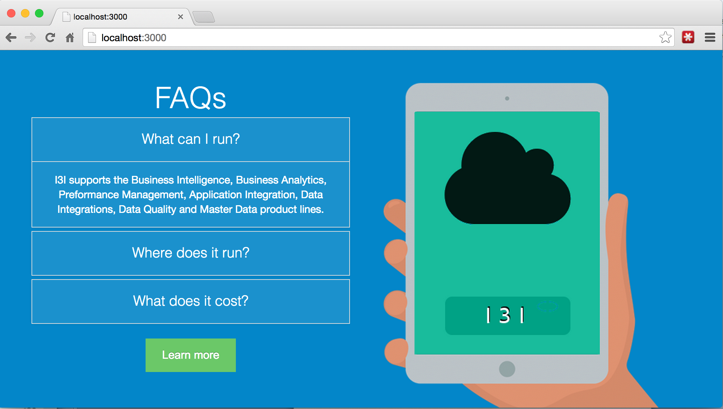
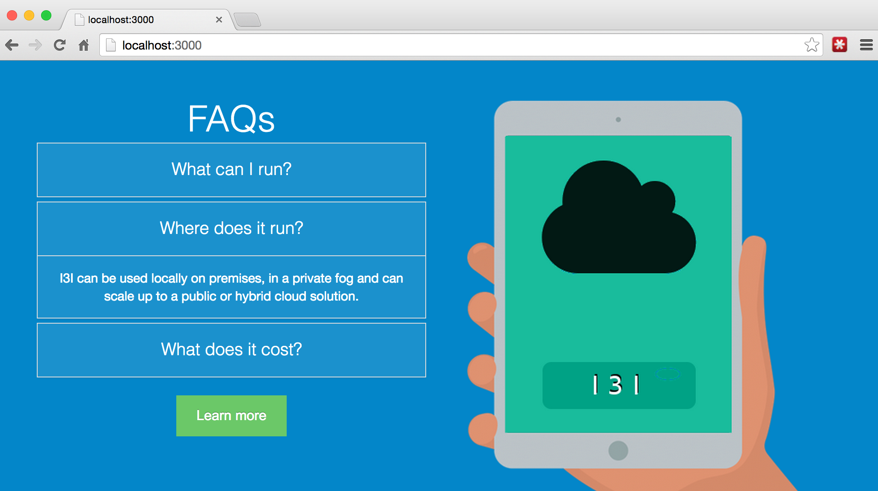
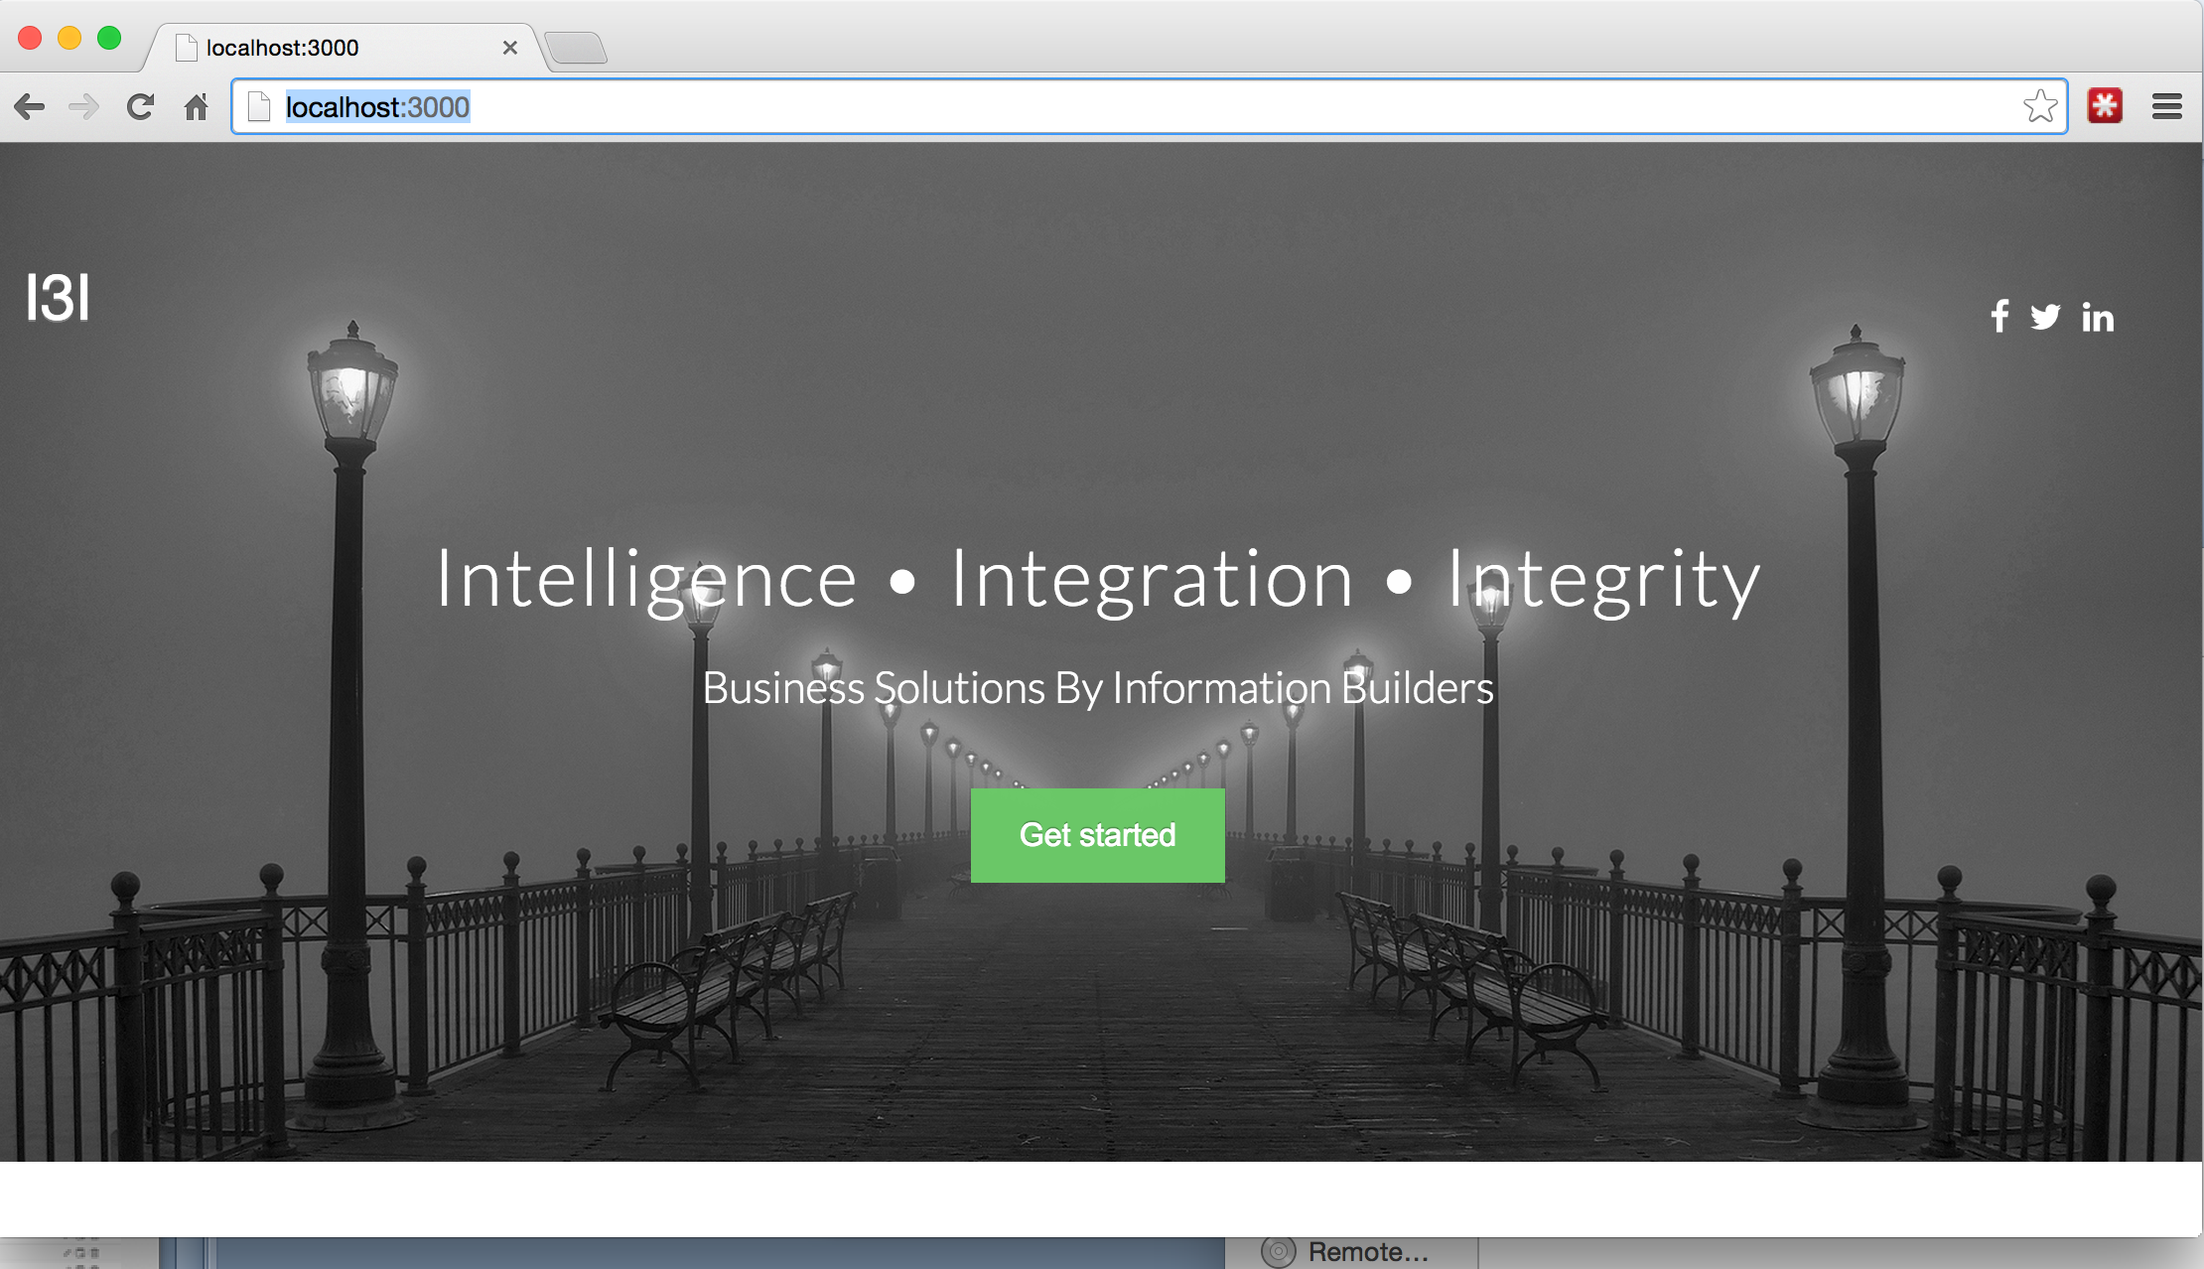
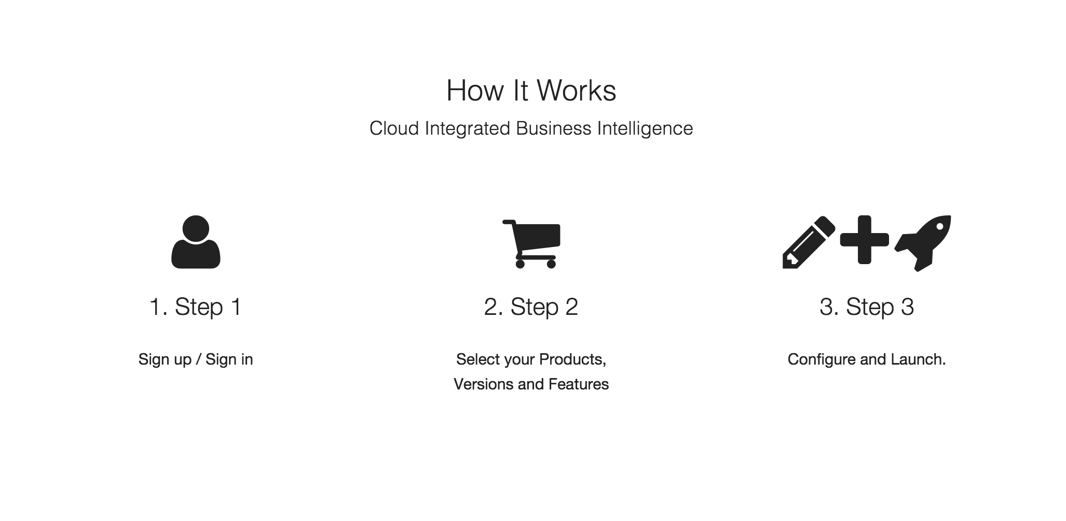
I3I – Customer View
September 2014

Slide 20
20

Slide 21
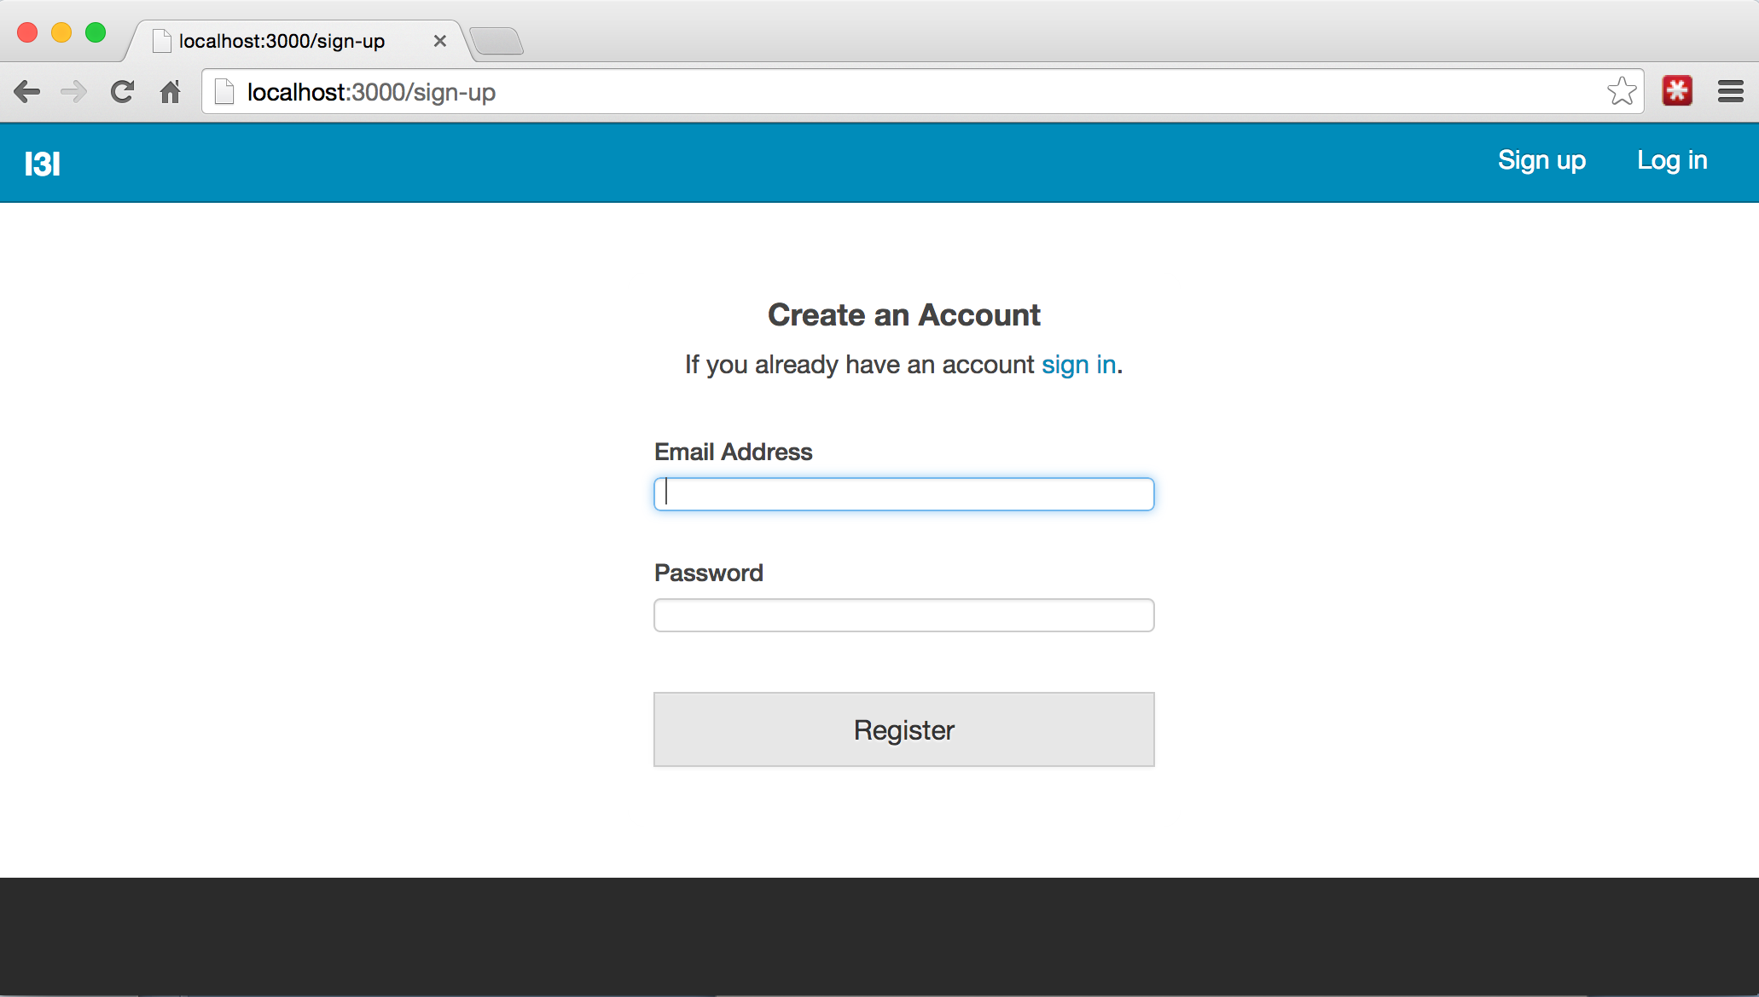

Slide 22
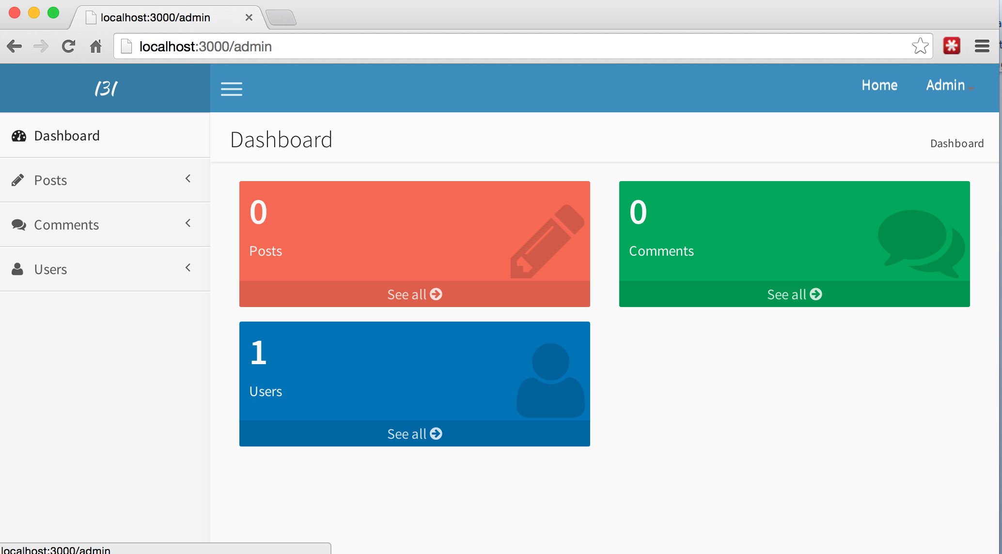

Slide 23
Cloud Trends Uncovered
You sell hardware you sell cloud, You buy hardware you buy cloud
There are different classes of clouds
Mult-instance over Multi-tenancy (security)
IoT is driving cloud to endpoint integration
The cloud has emerged as the future business platform
23

