Slide 1
DataLink
BuildingLink Analytics
Marc J. Greenberg Apr 2018

Slide 2
Why (value drivers)
Existing Customers
Vehicle to enhance data for product offerings
Fast path to make production data actionable
Internal Operations
Enable executives to play with BuildingLink data
Data exploration, self service, non technical
New markets, potential ideas
Report(s): definition, generation, publication and distribution
Insights, embedded in the platform, embedded in email
Building Data As A Service (BDAAS)
April 2018

Slide 3
What (content)
Multidimensional Tabular Data Models
BuildingLink (Internal use only, The whole shebang!)
Consumer Based ( customer specific, managing agent, building )
Provider Specific ( app orientated, module based - insurance, pets, etc. )
Publically Consumable ( anonymized, sanitized, data nuggets )
DataLink Analytic API’s ( Data Governance )
Authentication (OAuth2 with BuildingLink Identity Services)
Authorization (Control thru the BuildingLink API)
Technical Bits as the Glue
BuildingLink! Connector for Microsoft Power BI
Embedded Content / Analytic Mashups
Analytic Reporting Subscription, (BDAAS)
April 2018

Slide 4
How (implementation)
Part 1: Technical Architecture
April 2018

Slide 5
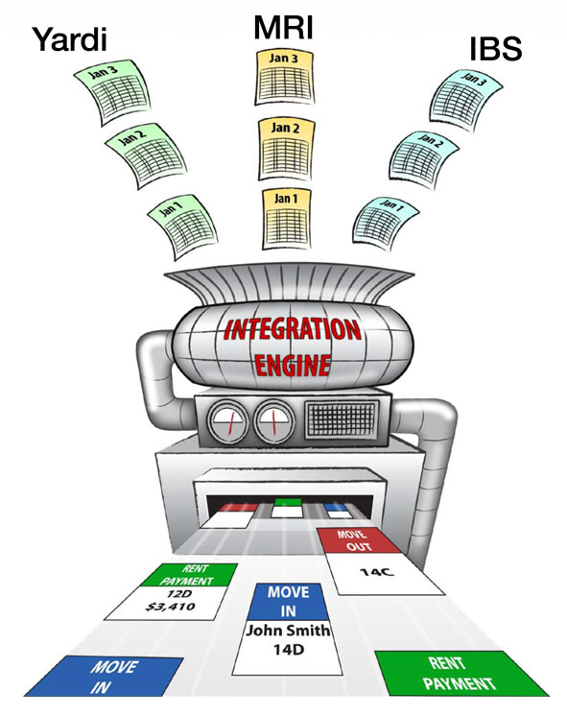
BuildingLink Data Ingestion
SysAdmin
PropEmp
Resident
MgmtCoUser
ProviderPerson
Data is Ingested as:
Buildings are Setup in BuildingLink.com
Users Interact with the BuildingLink Website
Devices Interact with BuildingLink WebServices
Sensors Interact with the BuildingLink Api
Integration interacts with External Software Packages
BuildingLink
April 2018

Slide 6
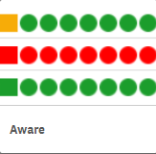
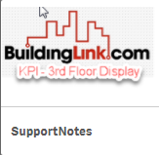
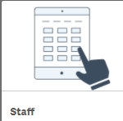
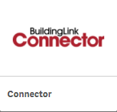
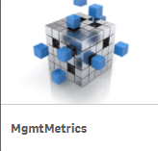
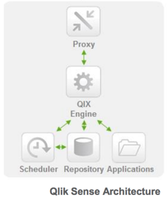
BuildingLink Analytics - it started with a Qlik
Integration with Qlik Sense
qlik.buildinglink.com
Mashups
BuildingLink
SysAdmin
Nightly ETL
PropEmp
admin 3000
BuildingLink Model
apps 3004
Resident
web 3005
Node Based Virtual Proxy
Windows Services
External Data File and APIs
MgmtCoUser
ProviderPerson
April 2018

Slide 7
BuildingLink Analytics – The QlikWay
Integration with Qlik Sense
The Good
in-memory engine, associative analytics
interactive applications
governed data discovery, visual exploration
design, deploy and manage on premise 1 virtual server
The Bad
While cool, the UI is quirky,
Steep learning curve for developer to customize
Not the best fit for use with the Microsoft data stack
Load script for complex data models and data preparation.
Classic BI and Scheduled reports requires additional products (N-Printing)
April 2018

Slide 8
Enter Microsoft Power BI – moving fast
Power BI Desktop
Power BI Service
On-Premise
Get Data
Model Relationships
Define Visualizations
Manage access, security, refresh
Data Access Gateway
MS Sql Server Database, Analysis Services and Report Server
Natural language query (Q&A)
Organizational constructs (workspaces, content packs, email subscriptions,

Slide 9
Power BI Connection Types
Import loads and stores the data within the Power BI model
at the time the model is created, size limit of 1G per model
Power BI Import
Model
Live Connection
Power BI interacts with the SQL Server Analysis Services model to get data on a per request basis
Power BI Live Connection
Model
Direct Query
Power BI interacts with the SQL Server get data on a per request basis. Model is stored in Power BI
Power BI Direct Query
Model

Slide 10
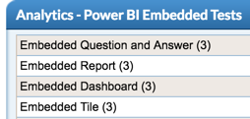
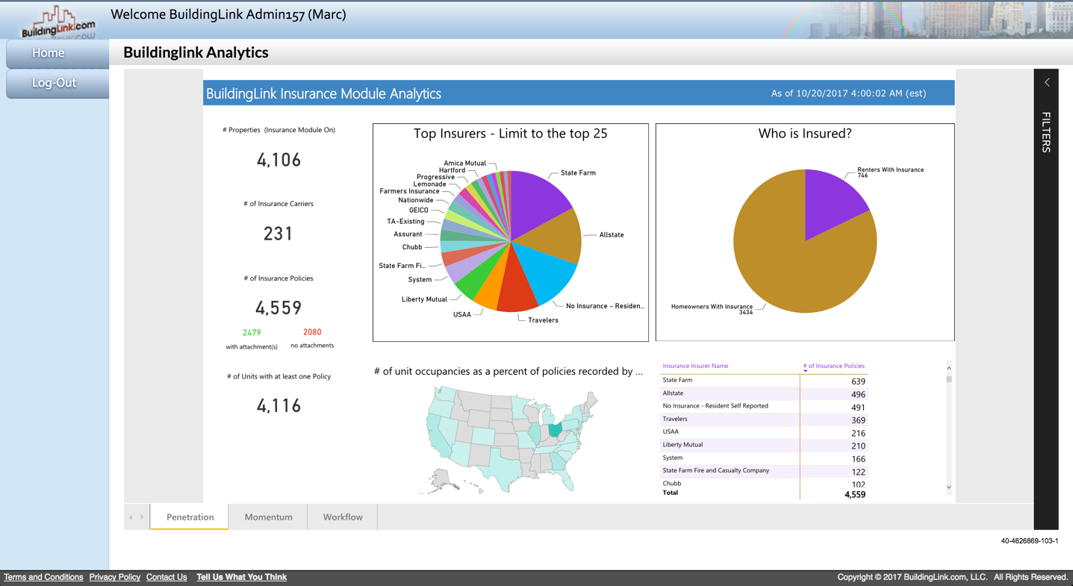
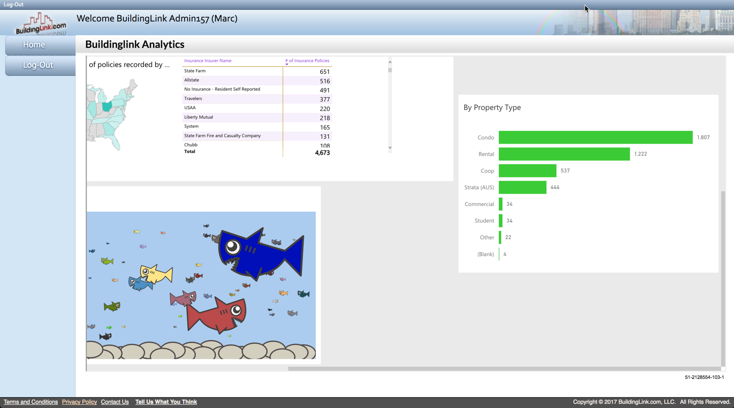
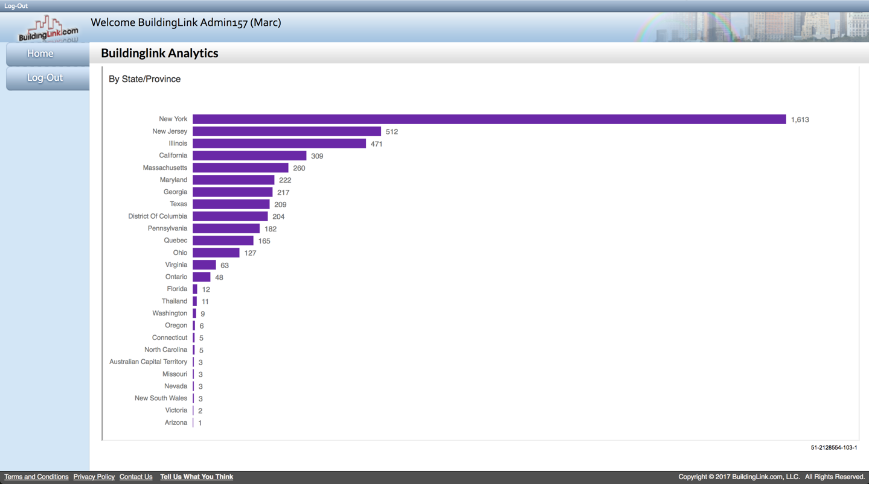
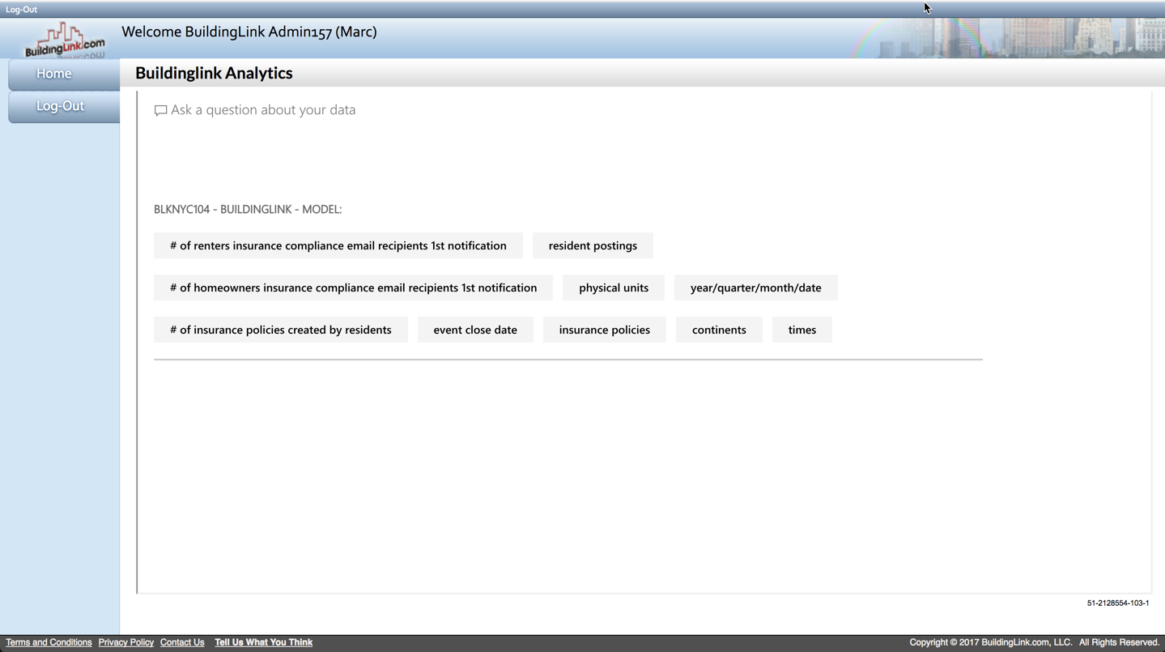
Power BI Embedded Types
see admin -> analytics submenu
Report
Dashboard
Tile
Question & Answers (QNA)
natural language capabilities
answers in the form of charts and graphs

Slide 11
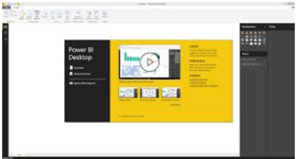
BuildingLink Integration with Power BI
Basic Embedding
buildinglink.com
Developer
BuildingLink
Creates and publishes Dashboards, Reports and Visualizations
SysAdmin
Nightly ETL
Authenticated as: powerbiwebsitemaster @buildinglink.com
Gain authorized access to Power BI authenticating with Microsoft via OAuth2 https://login.windows.net/common/oauth2/authorize
Using the authenticated bearer token, generate / acquire the embed token
Passing the embed token to the Power BI client (JavaScript) to retrieve, render and control the report
BuildingLink Model
Data is refreshed, Live, or on a schedule and cached
Report is injected into a div on the page
Azure Cloud / Power BI

Slide 12
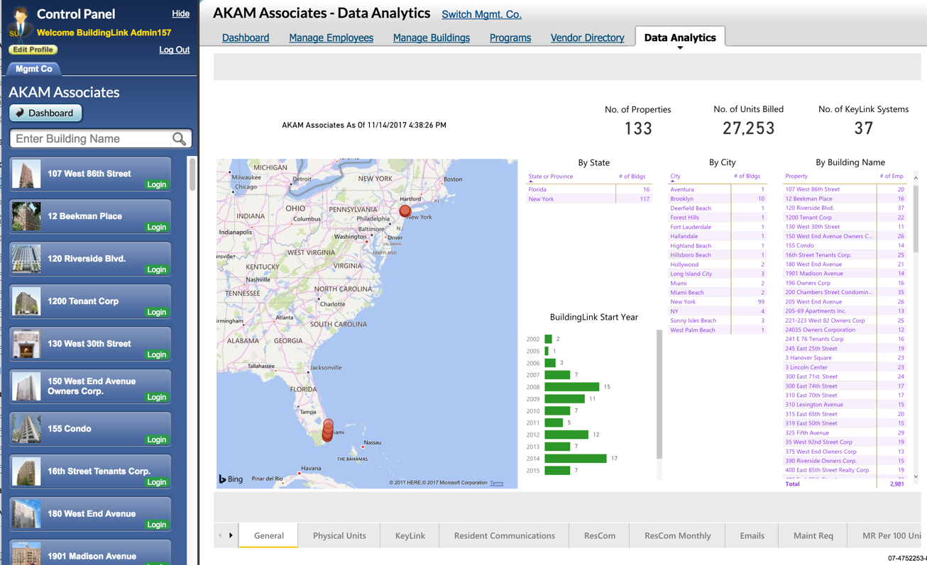
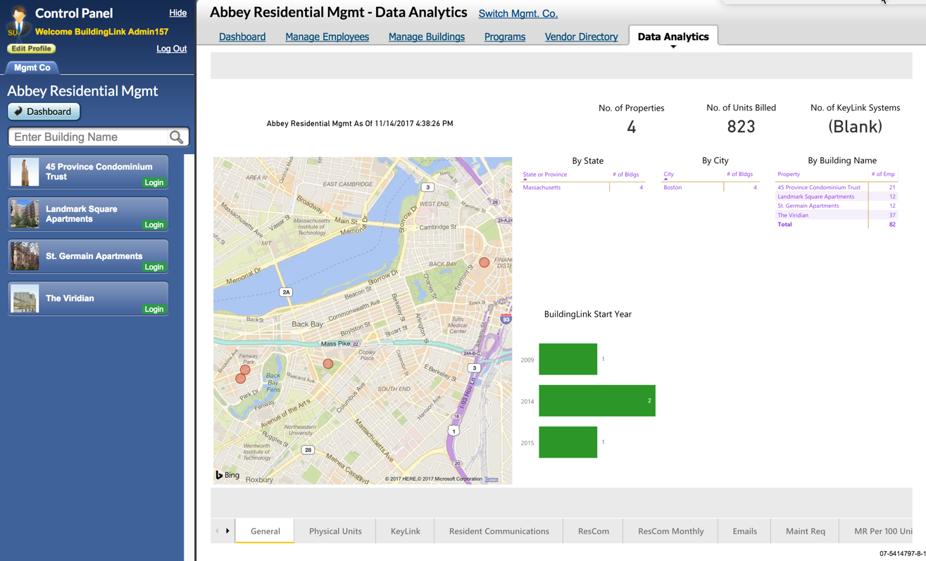
BuildingLink Integration with Power BI
Advanced Embedding
buildinglink.com
Business Analyst
BuildingLink
Generates content, stewards it thru an publication workflow with steps to; create, source, approve, and publish
Nightly ETL
MgmtCoUser
BuildingLink Model
MgmtCoUser
Data is refreshed, Live. Row-level security (RLS) is used to restrict the available data.
A BuildingLink user credential is passed as part of the embedded request to make sure that the correct data tenant /role is used.
Azure Cloud / Power BI

Slide 13
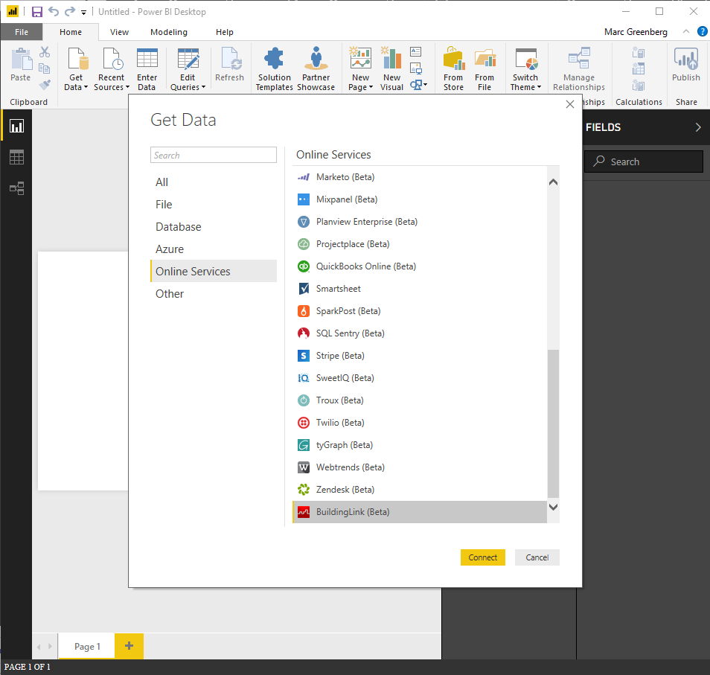
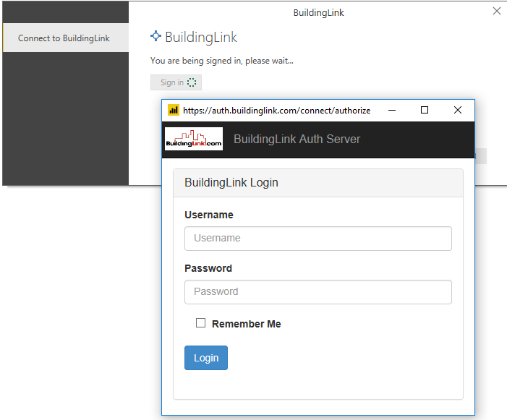
Introducing the BuildingLink Connector for Power BI
Do it yourself to get what you need
1. OAuth2 secure authorization
Identity Server3
Auth
BuildingLink
Nightly ETL
2. Call Buildinglink Api as an OData Service
Application Specific Model
API
BuildingLink Connector for Power BI is implemented in the Power Query M formula language
The connector does not currently support “live query”
API is served by the Azure API gateway
SSAS Entity
Framework
Provider

Slide 14
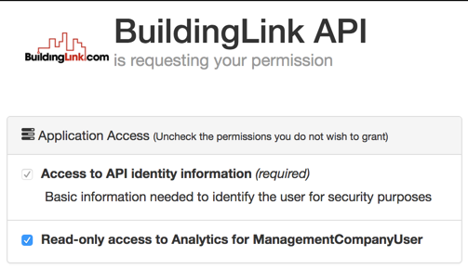
Introducing the BuildingLink Analytics API
As Exposed thru the BuildingLink Power BI Connector
Management Company / MgmtCompanyUser
Monthly Property Metrics
Resident Info
Resident Posting
KeyLink
Functionality
Logins
Movins
Employees
Properties
Name
Latitude
Longitude
ManagementCompany
State
City

Slide 15
How (implementation)
Part 2: Data Architecture

Slide 16
Its all about the data
BuildingLink Operational Datastore SQL Server Agent for ETL
Unified Data Model Views
BuildingLink Tabular Model
BuildingLink Cube

Slide 17
Analytic Models
BuildingLink
MgmtCompanyUser
PropertyEmployee
ProviderPerson
Resident
SystemAdmin
Unauthenticated
Multiple models

Slide 18
Breaking Down a Model
PropertyEmployee
Metadata
Temporal
Modules
People
Places
Things
Security
Freshness
Dates
Times
Users
Residents
Employees
Physical Units
Floors
IoT
Maintenance Requests
Insurance Compliance
Time Tracker
Containers
Properties
Unit Occupancies
Events
Incoming
Outgoing
Lines

Slide 19
Breaking Down a Model
PropertyEmployee
Source data is defined using SQL Views in a namespace associated with the model
CREATE VIEW pem.[Model Security]
AS
SELECT
[Property ID] = u.FacID,
[Property Name] = p.FacName,
[User ID] = u.userid,
FROM tblUser u
INNER JOIN dbo.tblFacilities p ON u.FacID = p.FacID
INNER JOIN dbo.UserSubType AS ust ON ust.Id = u.SubTypeId
WHERE u.delview = 0 AND u.useract = 1
AND ust.node.IsDescendantOf(CAST('/4/' AS HIERARCHYID)) = 1
AND ust.Node.IsDescendantOf(CAST('/4/3/' AS HIERARCHYID)) = 0
AND ust.Node.IsDescendantOf(CAST('/5/' AS HIERARCHYID)) = 0
-- AND u.FacID IN(217,554,1263,2142,3889,4249)

Slide 20
How (implementation)
Data Integration

Slide 21
BuildingLink Deployment Strategy with Power BI
Groups / Workspaces on the Power BI service http://www.powerbi.com/
BL Web Source
Can be edited and updated by BuildingLink staff
BL Web Staging
A testing step for use by the business
BL Web Live
Embedded Content on the live site meant for the targeted user
All workspace content is sourced at: https://tfs.buildinglink.com/tfs/BuildingLink/Default/_git/Analytics/PowerBI/Applications
Naming
0000 reserved 0400 unassigned 0800 unassigned
0100 ManagementCompanyUser 0500 Aware 0900 unassigned
0200 BuildingLink Admin 0600 PropertyEmployee 1000 reserved
0300 unassigned 0700 unassigned

Slide 22
How (implementation)
Part 3: Tool Chain

Slide 23
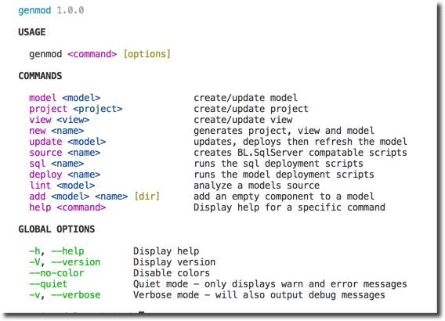
Introducing GenMod
A Model Maintenance Tool
Node based extensible – expandable
Generate, Build and Deploy
Scriptable CLI by design
Sources: sql, csv, and json
Targets: bim, smproj, views

Slide 24
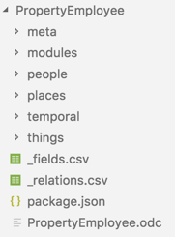
GenMod Design Principles
Editing text files should be super easy
Enabling a clean CI / CD flow is a first class goal
Grind-em up and out pops your model

Slide 25
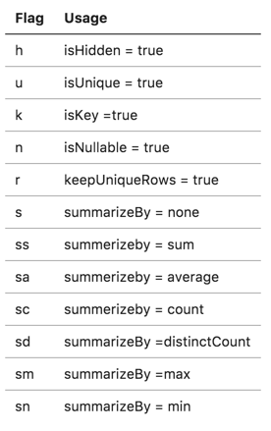
GenMod – Model Configuration Files
package.json
name on disk and in database
view namespace
views included
perspectives
_relations.csv
flags, tables, columns
h+u+k+n, table:table, field[:field]
_fields.csv
view, field, description
single location for all descriptions

Slide 26
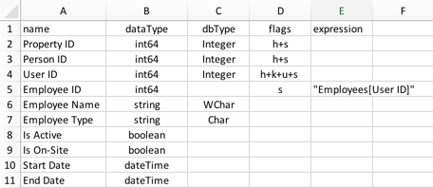
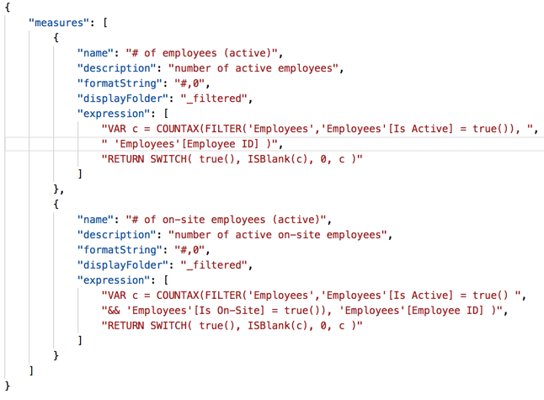
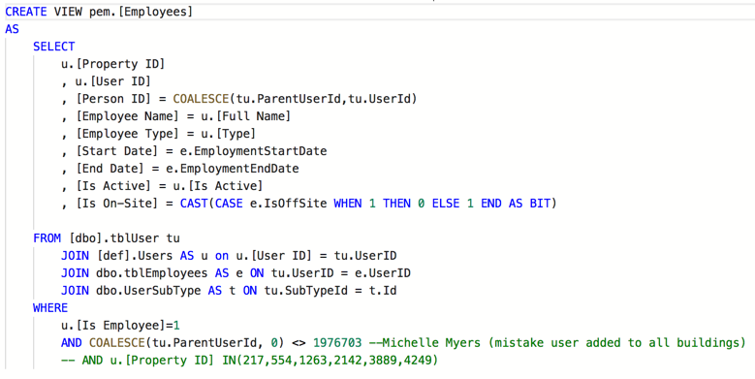
GenMod – Model Component Files

Slide 27
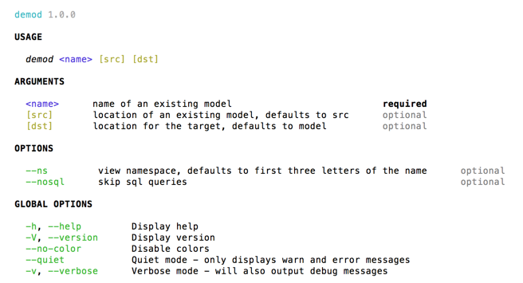
Introducing DeMod
A Model Decompiler Tool
Opposite of Genmod
Used to deconstruct and existing model to its source components

Slide 28
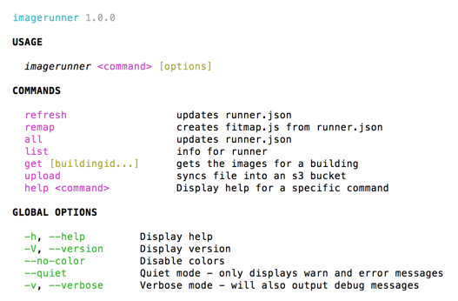
Introducing Imagerunner
A Image Extraction Tool $/Analytics/PowerBI/scripts
Use Case – save images generated by Power BI for Email
Dependent tools selected:
PhantomJS a headless WebKit scriptable browser with a JavaScript API
casperjs navigation, scripting & testing on top of PhantomJS

Slide 29
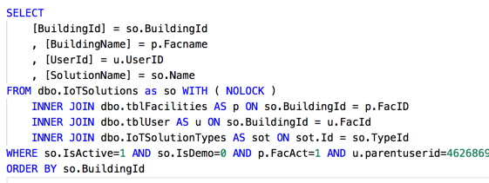
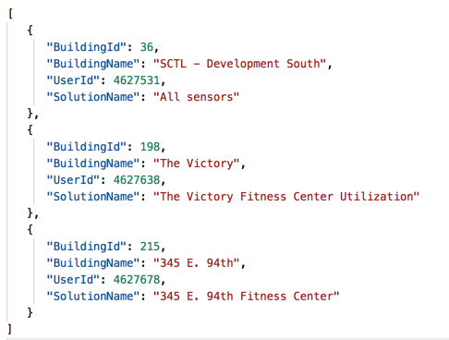
Introducing Imagerunner
The Fitness Center $/Analytics/PowerBI/scripts/fitness
$ imagerunner refresh turns runner.sql into runner.json configuration in package.json
runner.sql
runner.json

Slide 30
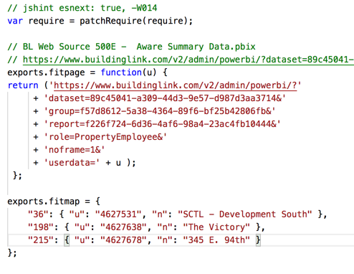
Introducing Imagerunner
The Fitness Center $/Analytics/PowerBI/scripts/fitness
$ imagerunner remap turns runner.json into fitmap.js
runner.json
fitmap.js

Slide 31
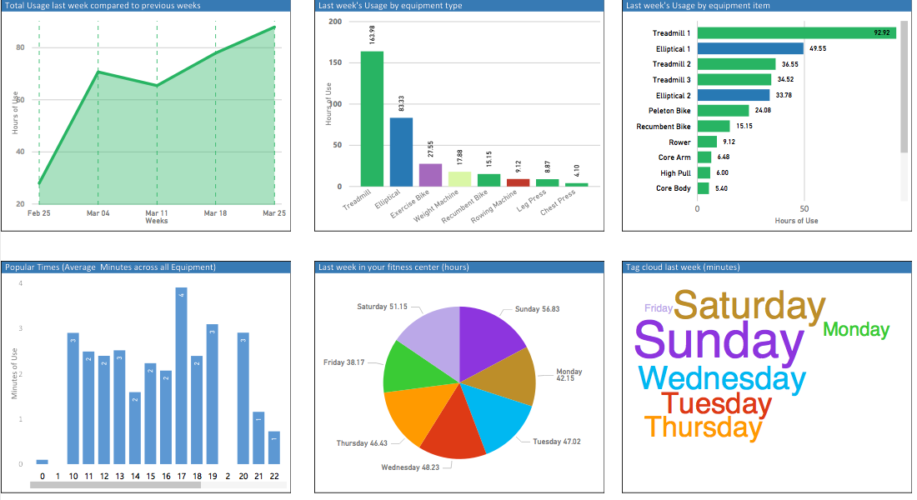
Introducing Imagerunner
The Fitness Center $/Analytics/PowerBI/scripts/fitness
quasar-3:fitness$ imagerunner refresh
Wednesday, April 18th 2018, 7:20:39 pm
saving runner.json
quasar-3:fitness$ imagerunner remap
saving fitmap.js
quasar-3:fitness$ imagerunner list
36 SCTL - Development South
198 The Victory
345 E. 94th
quasar-3:fitness$ imagerunner get 215
Wednesday, April 18th 2018, 7:21:56 pm
215 4627678 '345 E. 94th' '345 E. 94th Fitness Center’
Running: casperjs fitness.js 215
split time 00:00:24
elapsed time 00:00:24
quasar-3:fitness$ imagerunner upload
Wednesday, April 18th 2018, 7:33:51 pm Upload Starts
elapsed time 00:00:01

Slide 32
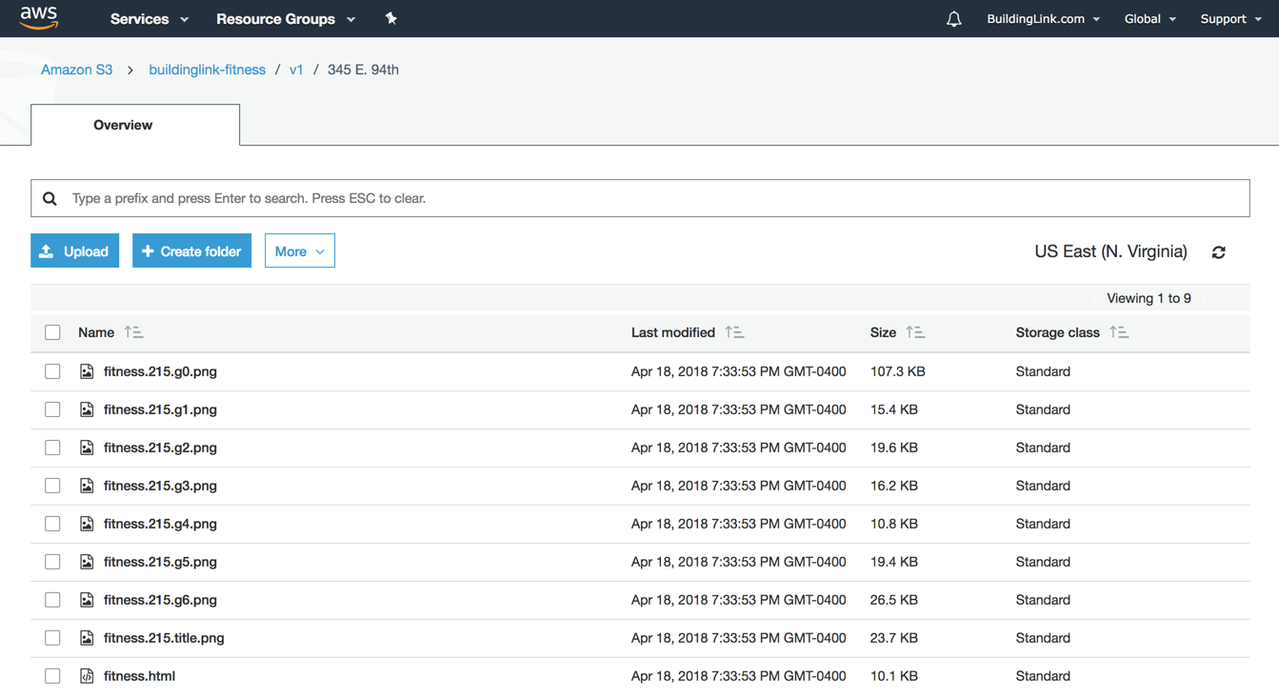
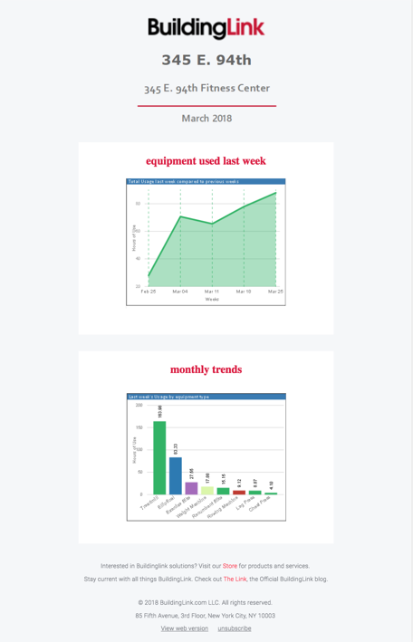
Introducing Imagerunner
The Fitness Center – the final product ready to mail!

Slide 33
Integration into the BuildingLink Mailer
FitnessCenterEmailToSend
Generate and Collect Images
Scheduler
MSGQ .WeeklyScheduled
FitnessCenterEmail BatchData
Email Batches Ready for Mailer
Create Fitness Center Weekly Email Batch
MSGQ .AllInfoCollected
Infrastructure
amqp.buildinglink.local
Notes:
Trigger = The heart-beat alert monitor (pingdom, OpManager, etc) hits the scheduling page /V2/Global/Jobs/Default.ashx, every few minutes.
Message for analytics are defined in BL.Data /Analytics/ServiceAccount/v1/
Message queues are named by their message names dot event that published
buildinglink/fitnessweekly:prod
|Node:8-alpine PhantomJS / CasperJS ImageRunner
BL.Data /Analytics/ServiceAccount/v1/CaptureForEmailRecipients.cs /Analytics/ServiceAccount/v1/FitnessEmailBatch.cs

Slide 34
Integration into the BuildingLink Mailer
FitnessCenterEmailToSend
Generate and Collect Images
Scheduler
MSGQ .WeeklyScheduled
MSGQ .ImagesCollected
Email Batches Ready for Mailer
Generate Narrative
FitnessCenterEmailBatchData
Create Fitness Center Weekly Email Batch
MSGQ .AllInfoCollected
Infrastructure
amqp.buildinglink.local
Notes:
Trigger = The heart-beat alert monitor (pingdom, OpManager, etc) hits the scheduling page /V2/Global/Jobs/Default.ashx, every few minutes.
Message for analytics are defined in BL.Data /Analytics/ServiceAccount/v1/
Message queues are named by their message names dot event that published
buildinglink/fitnessweekly:prod
|Node:8-alpine PhantomJS / CasperJS ImageRunner
BL.Data /Analytics/ServiceAccount/v1/CaptureForEmailRecipients.cs /Analytics/ServiceAccount/v1/FitnessEmailBatch.cs

Slide 35
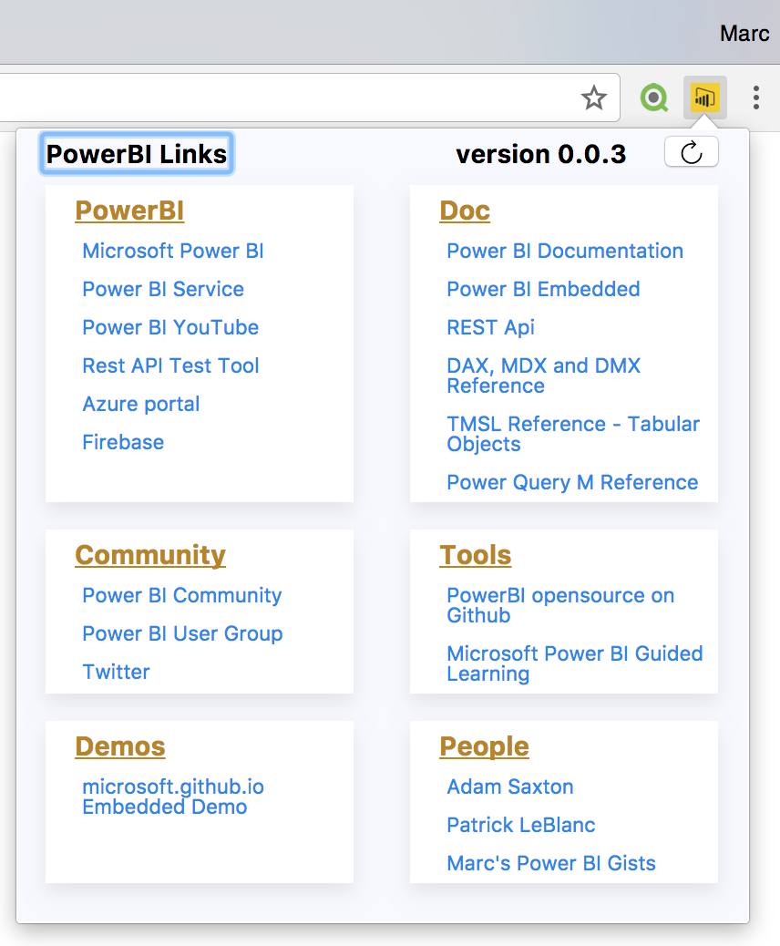
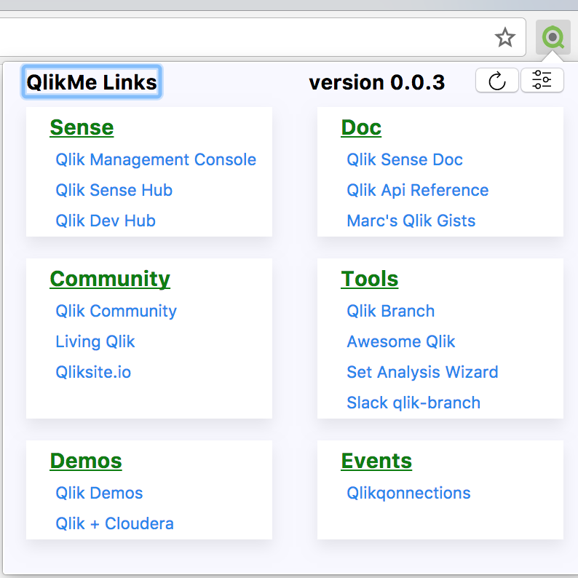
Chrome Extensions
PowerBi Me chrome webstore
QlikMe chrome webstore

